Slide 1
Federated Computing In The Real World: From Drug Discovery to Fraud Detection
September 2024

Slide 2
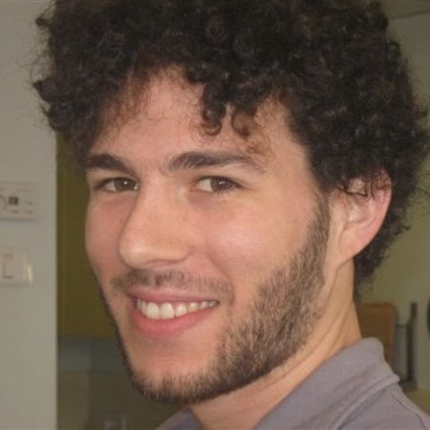
Rhino Speakers
Tal Tiano Einat
Lead Software Engineer
Chris Laws
Chief Operating Officer

Slide 3
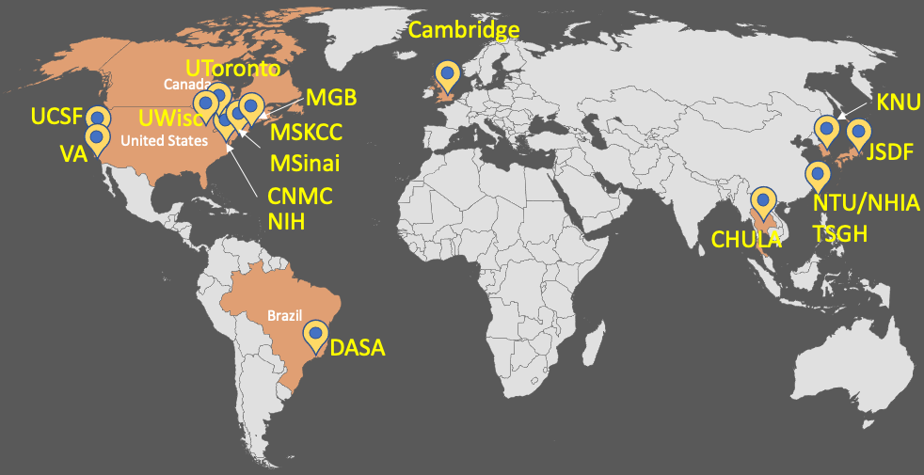
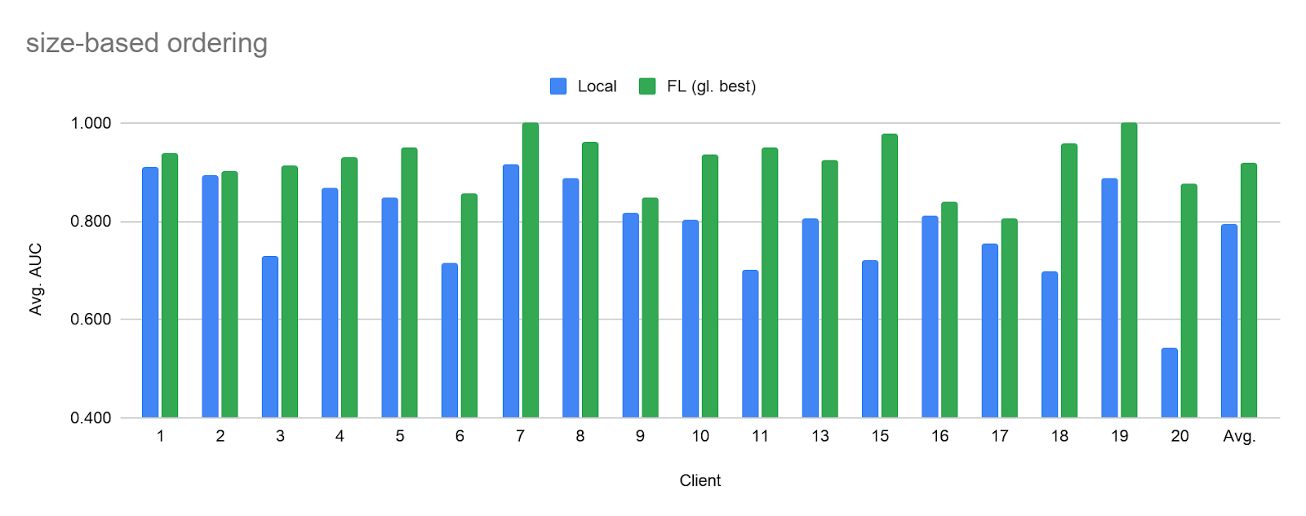
Rhino Health’s mission is to activate the world’s data with Federated Computing
Rhino has its roots in the NVIDIA- supported EXAM study…
…and we then built an end-to-end collaboration platform using FLARE
Rhino FCP Architecture
User
Enterprise
SDK
SDK/API
GUI
GUI
Global footprint of 20 sites
Contracts and IRBs completed in weeks
>16K cases of diverse data accessed
Model performance improved (~40% more generalizable)
Data custodian firewalls
Rhino Cloud
Data Partner 1
Data Partner 2
Data Partner 3
Notes:
EXAM
Enterprise-hardened platform for the end-to-end AI workflow from data engineering to model training and deploying custom code
Apps: Copilot, FD, TRE, FC (uses FLARE)
Installed in >50 leading hospitals and working with many of the top biopharmas

Slide 4
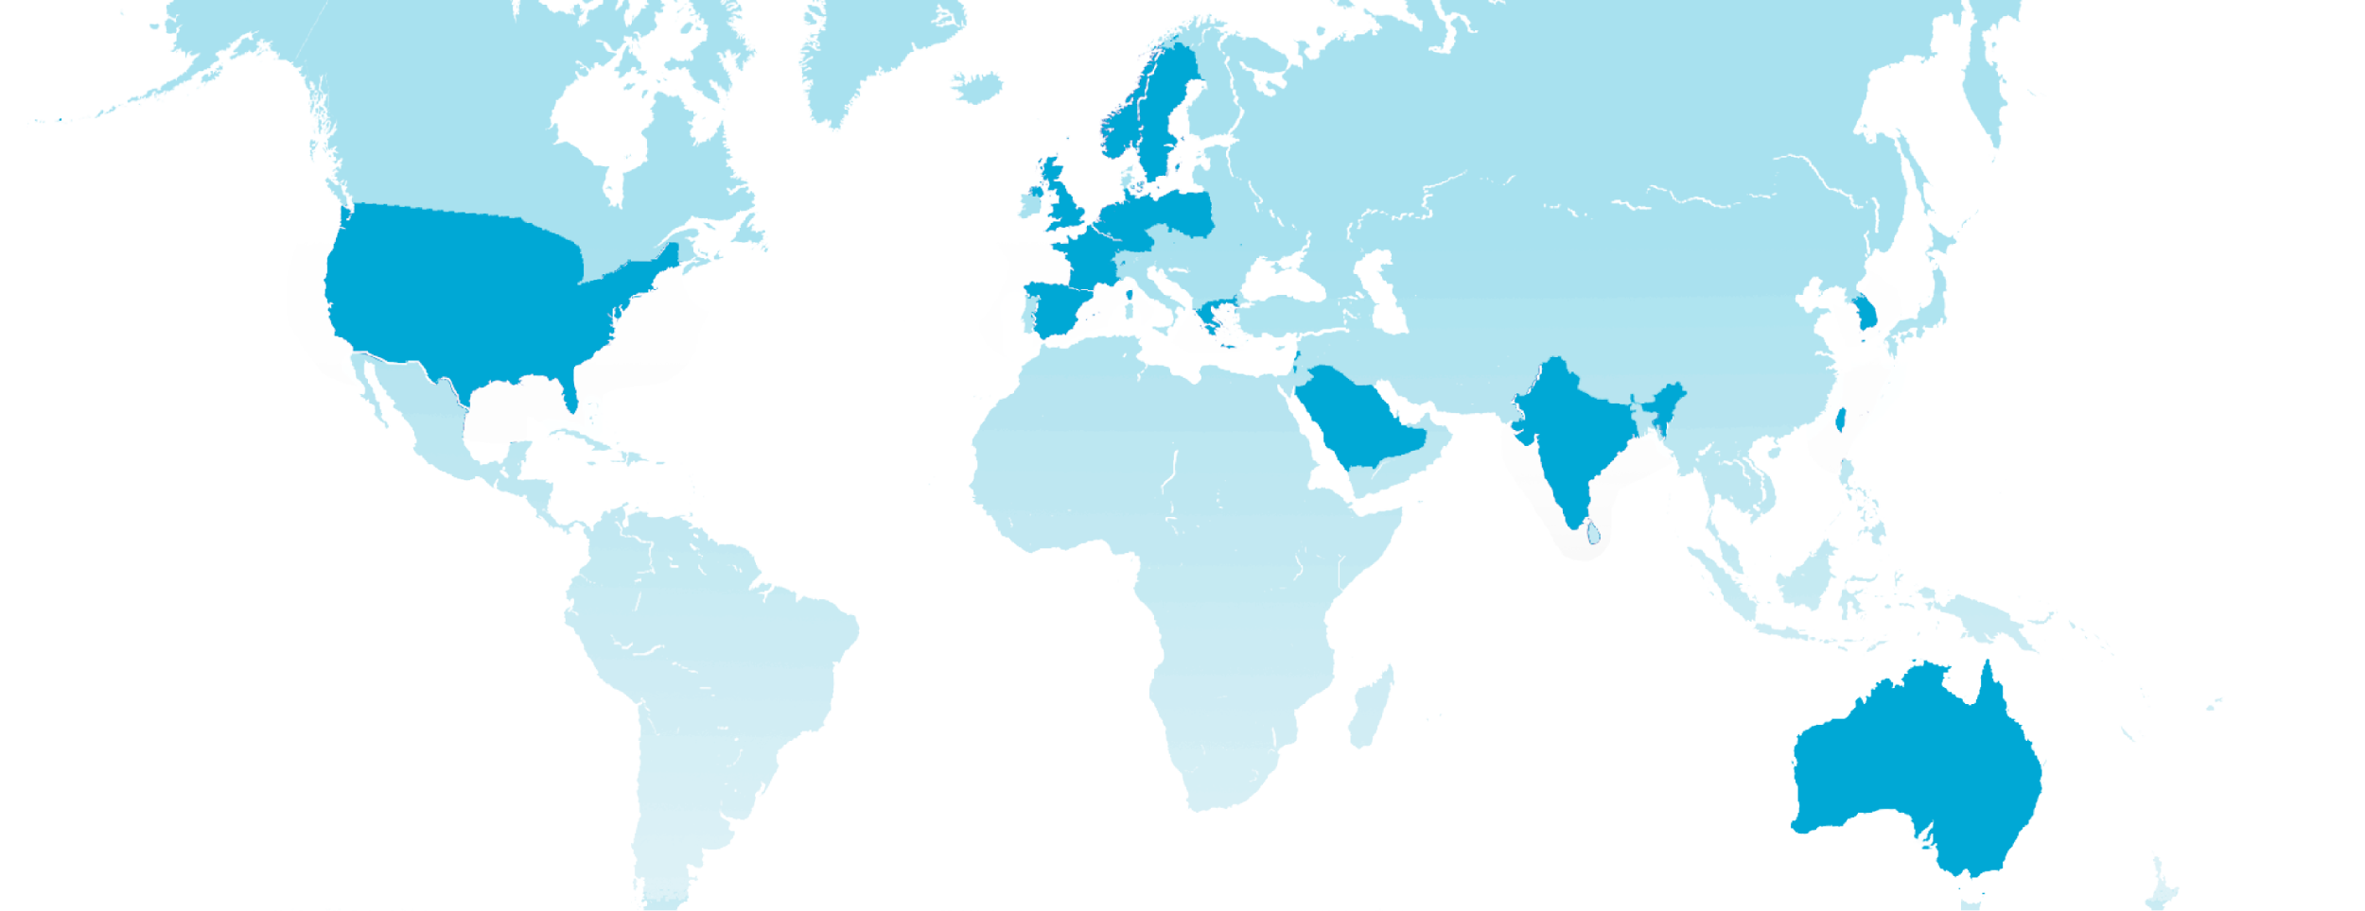
HCLS innovators from industry and academic leaders around the world are using Rhino FCP to support their projects
United States
Middle East
Stanford
UCSF
UC Santa Barbara
Cedars Sinai
UCSD
UNC Charlotte
Emory
Columbia
Wake Forest
University of Maryland
Beth Israel Lahey
Ohio State University
Dana - Farber
Massachusetts General Hospital
Case Western Reserve
Rensselaer Polytechnic Institute
Fox Chase Cancer Center
American College of Radiology
Children’s National
MD Anderson
Maccabi Healthcare Services
Sheba
Assuta
Shaare Zedek
Tel Aviv Sourasky
Saudi IAG
Europe
Cambridge
Oxford
Saint Luc’s
Erasmus MC
Aarhus
Karolinska
Norwich and Norfolk
Darmstadt
ZGT (Ziekenhuisgroep Twente)
NTNU
University Hospital Cologne
Asia-Pacific
Seoul National University Hospital
National Taiwan University
Kyung Hee
KAIST
Sri Ramachandra Engineering and Technology
University of Melbourne
Select consortia
Select publications in peer-reviewed journals / conferences
NCI’s Early Detection Research Network (Pancreatic Ca)
NIH’s MOMAH Neuro ICU (Hydrocephalus)
ICHOM ‘learning collaborative’ (Breast Ca)
PANGEA Pediatric Epidemiology (IBD)
AICT NetZero Digital Contrast
KAIST Neurodegenerative Disease
Dana-Farber Cancer Institute: NLP to predict readmission (BioIT)¹
Emory University: Prostate cancer image segmentation (ISMRM)²
Children’s National: Self-supervised learning for COVID detection (SPIE)³
Case Western Reserve University: DICOM image quality assessment (AACR)⁴
Massachusetts General Hospital: Brain aneurysm detection (SNIS)⁵
Massachusetts General Hospital: COVID-19 prognosis (Nature Medicine)⁶
1 https://dspace.mit.edu/bitstream/handle/1721.1/151725/Bio_IT_Federated_final-1.pdf?sequence=1&isAllowed=y
2 https://submissions.mirasmart.com/ISMRM2024/UploadPresentationVideo.aspx?sid=8gL7vmSih
3 https://www.spiedigitallibrary.org/conference-proceedings-of-spie/12927/3008757/CAFES--chest-x-ray-analysis-using-federated-self-supervised/10.1117/12.3008757.short#_=_
4 https://aacrjournals.org/cancerres/article/84/6_Supplement/2344/738823/Abstract-2344-Federated-image-quality-assessment
5 https://jnis.bmj.com/content/14/Suppl_1/A134
6 https://www.nature.com/articles/s41591-021-01506-3

Slide 5
Healthcare & life sciences organizations are using Federated Computing to accelerate their AI strategies
Federated Computing Solutions
Drug Discovery & Preclinical: Diverse, multi-modal data and GenAI to predict structures, binding properties, gene expressions, etc.
Clinical Development: Improve site selection and trial design. Use comprehensive, rapid-cycle insights to accelerate study phases and enhance trial outcomes.
RWE & HEOR: Conduct studies to gain critical insights into disease progression and health outcomes.
Post-Approval: Monitor drug performance. Help providers personalize treatments. Generate evidence to ensure access and adequate pricing.
Drug Discovery & Preclinical
Vestibulum congue
Vestibulum congue
Post-Market
Clinical Development
Vestibulum congue
RWE & HEOR

Slide 6
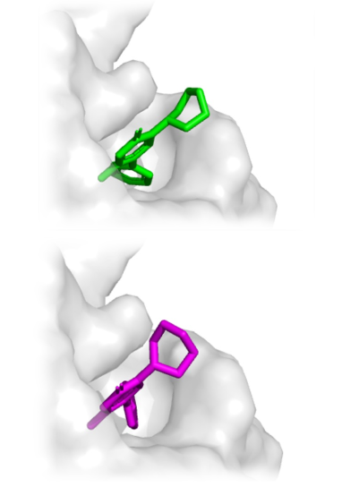
Biopharma Vignette: DiffDock
Business Problem: Leading BioPharma company evaluating federated training of molecular docking models.
Rhino Solution: Fine-tune the scoring function of DiffDock, a state-of-the-art open-source reverse-diffusion model. Supervised training using known good samples at multiple sites. On-platform federated data prep. and 3D visualization for results analysis.
Results: Federated model performs better than similar models trained at individual sites.
Notes:
The first example we’d like to present is a project we ran with a leading BioPharma company.
We fine-tuned the open-source DiffDock molecular docking model, which is a state-of-the-art reverse-diffusion model.
We compared doing so at several sites independently vs. combined in a federated fashion
As expected, the federated results were significantly better.
From inception to completion, the whole project took less than a month of work.
This includes the non-training steps such as data preparation and results analysis, which were also done on our platform.

Slide 7
Biopharma Vignette: Federated Regression Modeling
Business Problem: Leading Israeli HMO needed federated regression modelling for multi-site epidemiological studies.
Rhino Solution: Implement iterative federated algorithm supporting generalized linear models. Initially using Newton-Raphson, later using IRLS for robust convergence and better handling of sparse data.
Results: Models converged on all datasets, including ones with highly imbalanced classes. Excellent accuracy: Correct to 8 decimal points compared to modelling with centralized data.

Slide 8
Federated Computing also has many applications across financial services - wherever data sharing is challenging
Fraud Detection
Credit Scoring & Lending
Anti-Money Laundering
Trading Models
Payments Processing
Risk Management

Slide 9
Financial Services Vignette: Using Rhino FCP to fight fraud
Fraud Detection Consortium Architecture
Business Problem: Fraud is a trillion dollar problem, which requires complex collaboration among multiple orgs where data sharing is challenging
Rhino Solution: Rhino FCP provides a platform for secure data preparation and then federated training of a fraud detection model without requiring any data transfer, while preserving customer privacy & confidentiality
Results: The model trained on multiple sources of data shows significant uplift versus a model using only one source - providing huge benefit to participating banks
Consortium Leader
Rhino Control Plane
Bank 1 Rhino Client
(GCP)
Bank 2 Rhino Client
(AWS)
Bank 3 Rhino Client
(On-Prem)
Bank 4 Rhino Client
(Rhino TEE)
Notes:
Fraud is a multiparty problem involving customers, banks, payment processors, law enforcement, regulators, and tech companies
Data sharing is not possible due to privacy laws, competition, differences in regulatory regimes, and varying levels of technical sophistication
Multi-cloud - work on any hardware environment
Data stays at rest behind local firewalls
Rhino can enforce schema, exploratory analysis to ensure high quality data
Ephemeral TEE capability to help less sophisticated participants spin up / down compute resources
End-to-end encryption - including data at rest, in transit, and in compute (GCP + NVIDIA)
End-to-end attestation
Rhino manages ML Ops with FLARE

Slide 10
We are excited to see Federated Computing applications emerging across a variety of sectors
ILLUSTRATIVE
Education & Social Services
Evaluating program effectiveness across orgs
Tracking progress & outcomes for certain populations
Coordinating complex care for vulnerable individuals
Agriculture
Production & supply chain optimization to avoid waste/shortages
Privacy-preserving regulatory reporting (e.g. traceability)
Animal health monitoring
Manufacturing & Operations
Predictive maintenance to improve asset uptime, reduce total cost of ownership
Supply chain optimization - improve ‘just-in-time’ manufacturing & logistics
National Security & Intelligence
Critical sector supply chain risk assessment
Anti-terror predictive models
FCPA, PATRIOT Act, and other compliance monitoring

Slide 11
Thank you!
To learn more, please visit our website at rhinohealth.com.
For a demonstration of how Rhino FCP can accelerate your work, please reach out to contact@rhinohealth.com.

