Slide 1
Confidential federated learning for multi-party product recommendations
NVIDIA Flare Day
18 September 2024
Iustina Vintila
iustina.vintila@rbc.com

Slide 2
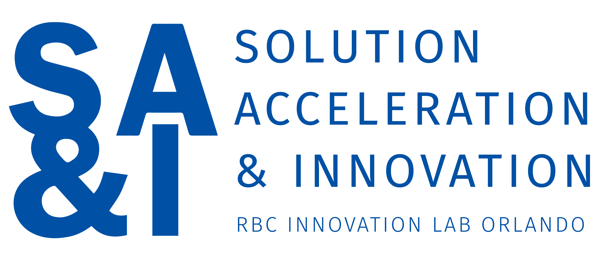
What I do:
Support product owners with AI application and design decision patterns
Distill unifying architectures to increase internal adoption of AI technologies in systematic and principled ways
Evaluate and help adoption of confidential computing infrastructure, models, frameworks, etc. from external providers
Iustina Vintila
Data & AI Innovation

Slide 3
Overview
1
Context
The role of SA&I and our work in the federated learning space.
2
Premises
Sketch premises and classes of actors at the basis of our architecture work with federated learning and various product lines.
3
Previous Federated Recommender
Outline previous work on using NVFlare for federated training of recommender models.
4
Approach
Present our architecture approach meant to support federated learning and applications.
5
Future Considerations
Propose considerations and evidence of business and technical capabilities we allege are necessary for adoption of federated learning and applications. This is ongoing, based on our understanding of NVFlare so far and it is continuously validated with NVIDIA product leads.
Disclaimer: This is our current understanding so far, from practice and research and we still need further investigations to converge.

Slide 4
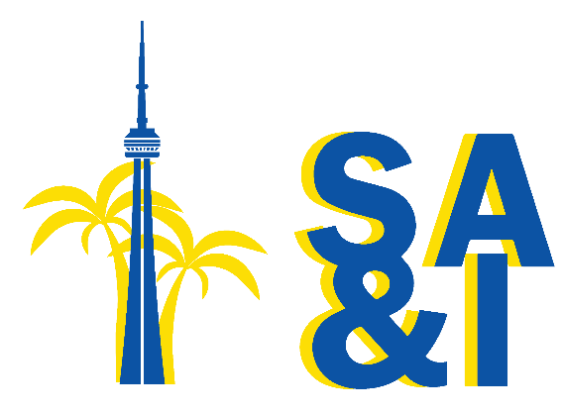
Solution Acceleration & Innovation – Testing & Learning in Canada’s Largest Bank
As a regulated financial institution, RBC is committed to maintaining and increasing customer trust by ensuring the privacy and confidentiality of consumer financial information.
SA&I was founded as the first innovation lab at RBC, with a strong focus on payments and loyalty.
We are focused on bringing value to RBC and strengthening and future-proofing our client interactions, helping clients make better decisions to optimize their spend, and delivering loyalty in new ways.
Background:
In 2017, we embarked on an initiative to create multi-party analytics and insights while preserving privacy using confidential computing technologies.
We are leveraging confidential computing to create "clean rooms" where data custodians can collaborate on analytics without directly exposing or sharing their underlying data.

Slide 5
Context – Premises: In a large organization with various stakeholders, we need a broad and well documented framework, which can form a basis for effective communication and decision-making.
For federated learning, in general, we propose the premises about key business and technical capabilities in scope of application architectures we distill.
For NVIDIA Flare, specifically, we are working with key NVIDIA stakeholders who confirm importance of these capabilities as part of enterprise adoption of the framework.
Federated learning…
…Performs across heterogeneous organizations and their data and devices
…Involves various kinds of data custodians, model providers and users, who seek collaborative intelligence
To achieve business value & monetization it requires verifiability, accountability & reproducibility even in enterprise settings, where trust is based on priceless business reputation & business contracts, but also in democratized applications…
…For collaborative intelligence/AI the "model is not the product", hence we need architectures for beyond model building
…With complex business data requires data governance & data discoverability across federation (data quality proofs, adjusting for imbalances, etc.)
…With confidential data and applications requires federated identity management, key management
…With confidential data and applications requires access control of data and resulting models must be also verifiable and "end to end" across (federated) training loops, but also in applications.
…Is part of the data development lifecycle and model development lifecycle (model evals, fine tuning, etc.) beyond initial model building, so we need to continuously detect and handle data shifts, concept drifts.
…For RAG applications (LLM retrieval augmented generation) / GenAI apps, access control must cover both training data as well as RAG data (of data custodian, including user data).
As such, "federated" / "federation" is about much more than the training loop and model building.

Slide 6
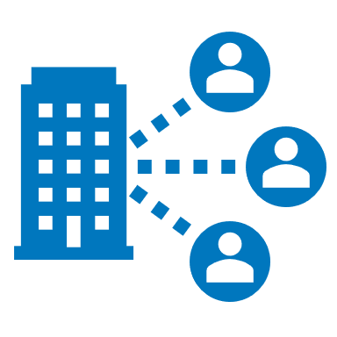
Context : To Level-set, let’s introduce the classes of actors in a federated setting and 3 key concepts
Application Providers
Verifiable AI
Defines business requirements, implements and deploys application logic
Each step of the AI process is documented and tracked. Trained model can be traced back to the training data sets and respective data custodians. The model performs according to a known benchmark, respects certain rules and metrics.
Data Custodians & Owners
Model Builders & Providers
Accrued valuable data, worthy enough to at least protect. They seek to leverage, share/trade and even monetize.
Have invested extensively in model building capacity and domain specific models and seek to monetize..
Collaborative AI
Classes of Actors
Data custodians, model builders and infrastructure providers collaborate to enhance the quality of the insights.
End users
Shoppers / Consumers
Open to offers on the last leg of the value chain
Infrastructure Providers
Provides the compute infrastructure, including confidential computing
ML Monitoring
End users
Monitoring and continuous improvement for ML systems to track key performance indicators over-time
Prosumers
Able to manage and value own data, willing to partake in marketplaces and collaborate with AI to discover domains of knowledge (home renovation, retirement planning, etc.)

Slide 7
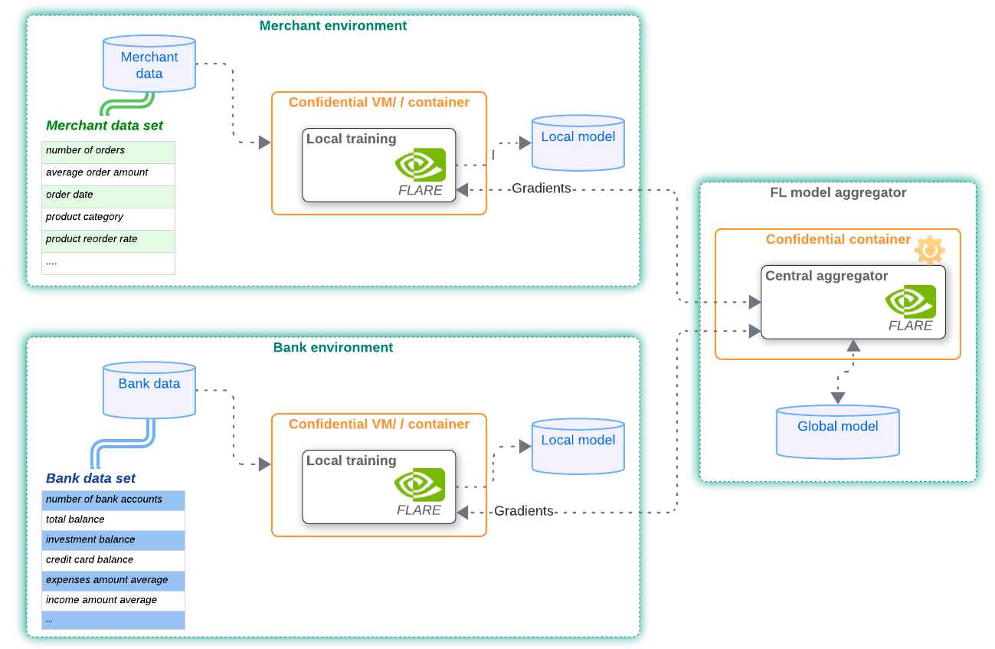
Scenario: Working with a merchant, we developed a federated model to generate insights jointly without sharing data across parties
Seeks to provide more personalized insights to customers, despite having a wealth of data on their side.
They are reluctant to share sensitive data with third parties.
Merchant
Next Purchase Experiment
A federation formed from 2 parties - bank and merchant - collaborating to train a model jointly, using synthetic and public data sets.
The model’s objective was to predict the product which will most likely be purchased by the customer, during his next shopping trip.
Has additional insights into customer banking profile and would like to expand its offers to be specific to client's needs. Preserving data privacy is a key requirement.
Bank
What’s Next?
A LLM-based with RAG recommender, where we’ll explore federated learning and fine-tuning with Flare, focusing on evals / validations as part of Flare orchestration flows.
This article Leveraging LLM Fine-Tuning and RAG for Advanced Recommendation Engines provides additional information on why LLM with RAG system can “act as a better Recommendation System“
Solution
A collaboration between both organizations, where they can generate insights jointly, without directly sharing their data assets and protecting them at rest, in motion and during computations has clear benefits for both.

Slide 8
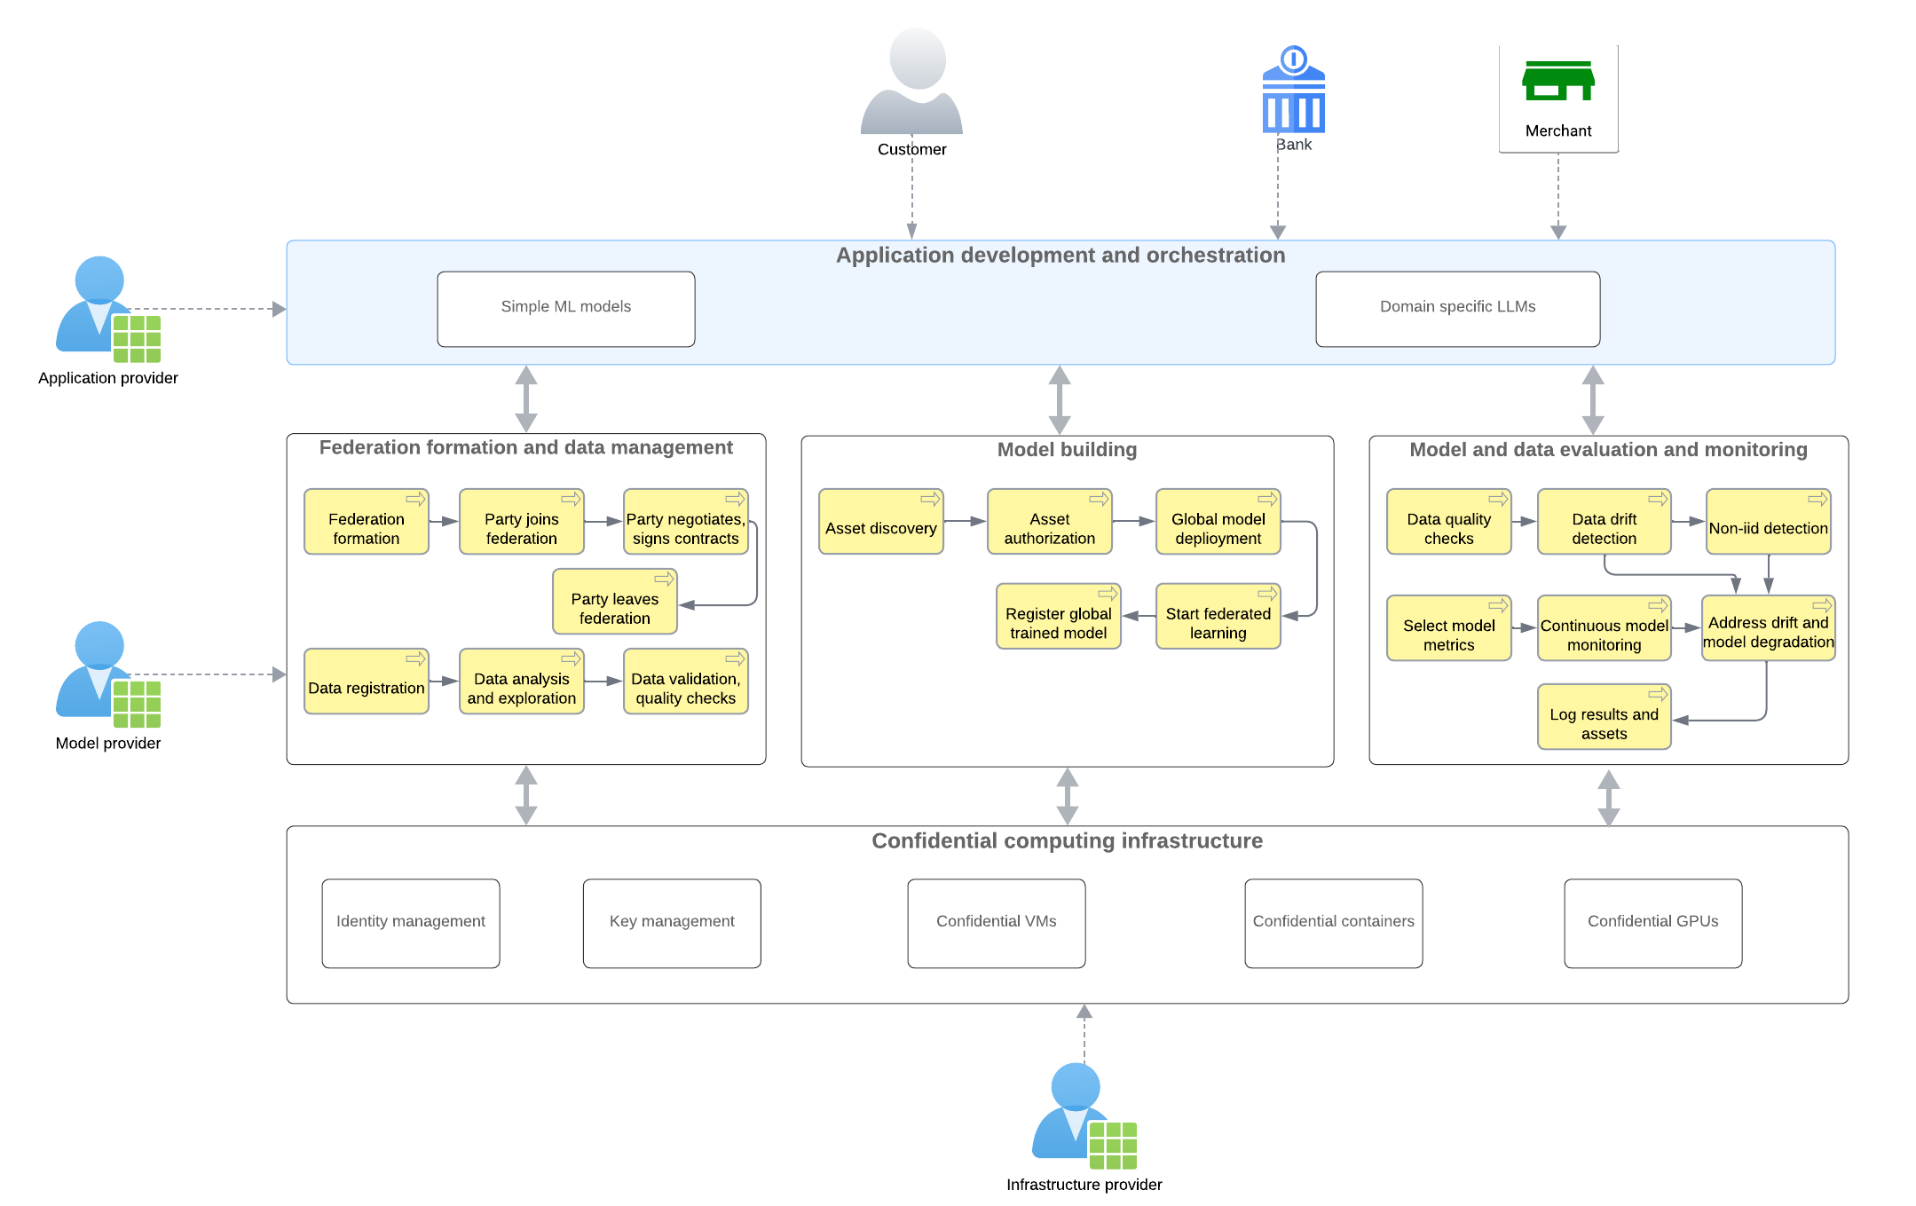
Proposed Approach: We are distilling a unified approach to confidential, collaborative, verifiable AI models and applications from state-of-the-art frameworks, architectures and processes.
We aim to leverage a federated and collaborative DDLC (data development lifecycle) and MDLC (model development lifecycle)

Slide 9
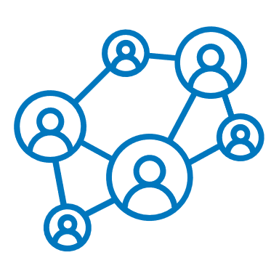
7 Areas of Consideration: In order to achieve broad enterprise adoption of federated learning, there are 7 areas we’ve identified that are critical to get right.
01
Federation Formation
02
Access Control
Governance with formal contracts and processes for joining and leaving a federation are required to protect the integrity and security of the data and models
Depending on the situation, fine grain access control of the data and model are a good complement to the existing authorization layer that Flare provides
Access Types:
Role based: data analysts at merchant site can access aggregated order data for their customers
Purpose based: data sets are only used for federated learning purposes, not for reporting or other analysis.
Time based: data sets are shared between parties for certain periods of time (ie only 2 days, during federated training)
Column level: sensitive columns such as SKU prices
Considerations for Joining Federation:
Attestations needed for
data quality, model code, application orchestration
the orchestration flow
that the model code is authentic and not malicious
Contractual obligations
Examples of terms: data sets to abide by certain quality metrics, certain sizes, and data schemas and who has access to the data and model assets
data contracts between parties
Considerations for Leaving the Federation:
Algorithmic Fairness & Model Performance Risks - Without data contributions from one party during training, risk of bias and imbalance of the global model
Notes:
So what will it take for broad enterprise adoption? There are 7 areas we believe are critical to get right
Join, tcs and cs, conditions for how to – may need to complemented with a layer of governance, and how they leave – collapses;
Complement with Fine grain access control of the data and model – the model global wise asset – protect it

Slide 10
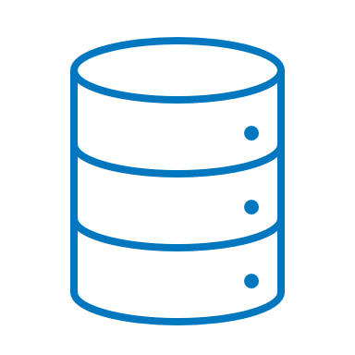
7 Areas of Consideration: In order to achieve broad enterprise adoption of federated learning, there are 7 areas we’ve identified that are critical to get right
03
Data Management
04
Application-level Orchestration
Complex data loading and validation scenarios to ensure accurate and timely insights are needed (and underway)
Additional checks and balances outside of the NVIDIA Flare environment to control and monitor user access
NVIDIA Flare implements different types of workflows for FL processes:
Scatter-gather
Cyclic
Swarm learning and so on..
Application-level orchestration covers activities before and after federated training processes, such as:
key management
data load
data protection
access control policies for assets: data, models
data quality verification
trained model protection, etc.
Data Validation:
NVIDIA Flare provides federated statistics across parties & has additional checks on their roadmap
Validation of the data at large, across federation: statistical properties across federation for all data sets to verify non-IID aspects, quality, data drift etc.
This is an active area of research to have data quality checks in multi-tenant and federated environment, especially with privacy guarantees.
Data Loading:
NVIDIA Flare recently introduced streaming for large language models across federation.
For continuous learning and feedback loops or in scenarios where local data sets are larger, there is a need to have a streaming data loading component integrated with local federated training process.
Notes:
So what will it take for broad enterprise adoption? There are 7 areas we believe are critical to get right
Join, tcs and cs, conditions for how to – may need to complemented with a layer of governance, and how they leave – collapses;
Complement with Fine grain access control of the data and model – the model global wise asset – protect it

Slide 11
7 Areas of Consideration: In order to achieve broad enterprise adoption of federated learning, there are 7 areas we’ve identified that are critical to get right
05
Evaluation & Monitoring
06
Model Explainability
07
Confidential Computing
Early and continuous monitoring is required to manage model performance
Explanation of models needs to be included as they are rolled out more broadly
As confidential computing matures, it will impact how we work and expand
LLM evaluations is complex and applying software engineering best practices (unit testing, assertions etc.) is needed:
early monitoring and detection of data drifts will ensure model performance remains effective, accurate and relevant
monitoring model performance is needed both at the local level (federated party) and at the global aggregator site.
During our experiment, we selected basic model metrics to monitor during training and validation, such as: F1 score, accuracy, loss function etc.
Explaining model predictions allows end users to understand and trust the system's behavior in dynamic environments.
Complementing NVIDIA Flare with built-in mechanisms for explaining the causes of concept drift or the reasons behind model adaptations will support this aspect.
Adding explainability techniques such as SHAP or others, will help to observe the importance of each input feature of the model, while keeping data private in the federation.
Confidential computing infrastructure (confidential VMs, confidential containers, GPUs) will protect the computational processes during federated data processing, local training, model aggregation and evaluation. This is an out-of-the box integration within NVIDIA Flare.
A confidential (multi) GPU cloud during federated training time can be orchestrated using NVIDIA Flare.
By orchestrating confidential computation workflows at training time, where each participating node has confidential VM and confidential GPU, the load will be parallelized to obtain better scalability.
Notes:
So what will it take for broad enterprise adoption? There are 7 areas we believe are critical to get right
Join, tcs and cs, conditions for how to – may need to complemented with a layer of governance, and how they leave – collapses;
Complement with Fine grain access control of the data and model – the model global wise asset – protect it

Slide 12
Iustina Vintila
Innovation Architect, RBC
Thank you!
Interested in Today’s Topic? Have Questions?
Let’s Stay in Touch:
iustina.vintila@rbc.com

