Slide 1

Introduction to Jetson OTA Update
Notes:
Hi
Welcome to the tutorial for Jetson OTA upgrade.
This tutorial will outline the basic flow and instructions of how to do Over the Air software upgrade.
The content is applied to Xavier series and Orin series.

Slide 2
Overview
• | Over-the-Air (OTA) Update enables you to update NVIDIA Jetson devices and host computers for Jetson development
• | Jetson Over-the-Air update mechanism
• | Debian package management-based OTA
• | Image-based OTA
Notes:
First, we will introduce the mechanism for over-the-air update we support on current Jetpack releases.​
We support two kinds of mechanism. One is Debian package management-based OTA and the other is Image-based OTA​
Then, we will look into each of them and show the instructions separately. The content and examples are based on Jetpack version 5 and 6 releases

Slide 3
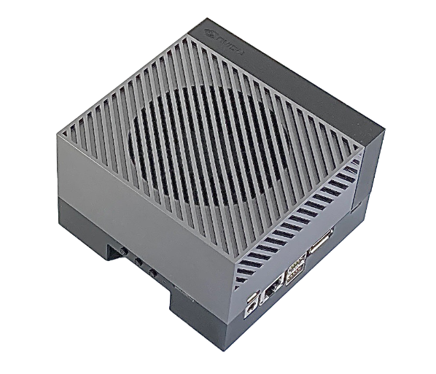

Jetson Over-the-Air update mechanism
There are two forms of OTA on Jetson:
Debian package management-based OTA
  This method of OTA uses the Debian package from NVIDIA APT server.
  Each Debian package has different functionalities and software to install.
1. Request for update
2. Install Debian packages
NVIDIA APT Server
NVIDIA Jetson developer kit
Notes:
Jetson provides two mechanisms for over-the-air update.
The first method is called Debian package upgrade. In this method, it will use pre-built Debian package from NVIDIA APT server to upgrade the bootloader, kernel and specific NVIDIA driver in the userspace. ​
This method requires internet connection. We can download the packages to Jetson device from APT server through network. And then start the upgrade process.

Slide 4
Jetson Over-the-Air update mechanism
Image-based OTA
  This method of OTA needs user to create OTA payload package on host machines, deliver the package to Jetson and then update the full image on Jetson.
  This kind of method is able to update cross major release. For example, rel-35 -> rel-36.
Jetson picks the right time to trigger OTA process
Prepare OTA payload
Send OTA payload to Jetson
X86 Host Machine
Jetson Device
Notes:
The second method is image based OTA. Unlike Debian package upgrade, this method will create one image package and use it to upgrade bootloader, kernel and NVIDIA drivers on jetson.​
To prepare the image, a separate x86 host machine with Ubuntu is required. We suggest you using the same Ubuntu host which is used to flash Jetson device for this work.​
​
Image based OTA can upgrade major release. For example, we can upgrade from rel-35 to rel-36 through image-based OTA. This is something that Debian upgrade cannot do.

Slide 5
Debian package management-based OTA
There are two procedures to update your system
Update to a new point release of same minor release. For example, you are on rel-35.1.0 and would like to upgrade to rel-35.1.1.
Update to a new minor release. For example, you are on rel-35.1 and would like to be rel-35.4.
Notes:
For Debian package upgrade, there are two choices. First one is to upgrade to a new point of release. For example, upgrade from rel-35.1.0 to rel-35.1.1. This is a common upgrade when we release some security updates.​
The second choice will happen between two minor release, for example, we would like to upgrade from rel-35.1 and rel-35.4.

Slide 6
Debian package management-based OTA
Update to a new minor release
Checking current version
Modifying the release version in /etc/apt/sources.list.d/nvidia-l4t-apt-source.list
Target version is rel-35.4
Notes:
Let’s show you a demonstration of how to do the upgrade between minor releases.
First, you can check your current Jetson Linux version by reading nv_tegra_release file shown on the screen. You can see that it is rel-35.3.1 in our example.
Since we are going to upgrade to a next minor release, need to modify the NVIDIA L4T apt source list to the target version.
In this example, we will upgrade to rel-35.4.

Slide 7
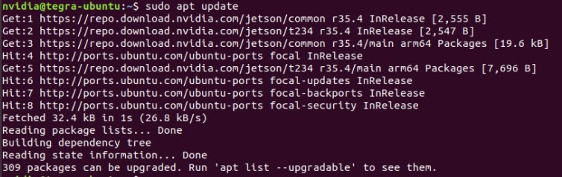
Debian package management-based OTA
Execute $ sudo apt update
The result shall show you the NVIDIA APT server with the version you modified in step2
Notes:
After modifying the apt source list, always remember to run apt update to let the change take effect.​
​
If there is no error, you shall see NVIDIA server information with the version you added.

Slide 8
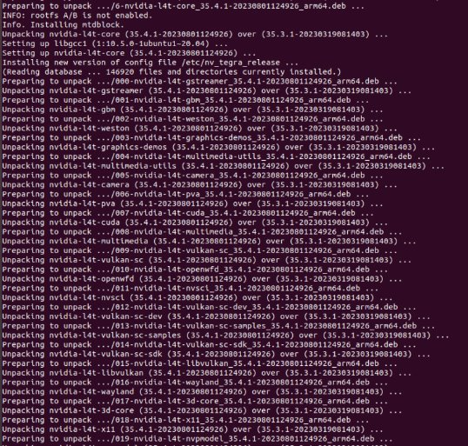
Debian package management-based OTA
Execute $ sudo apt dist-upgrade
This step shall start the upgrade. You shall see NVIDIA Debian package got installed as below screenshot
Notes:
After apt update is done, you can start the Debian package upgrade by running apt dist-upgrade command.
You shall see lots of NVIDIA deb package got installed with the target version you added previously.

Slide 9
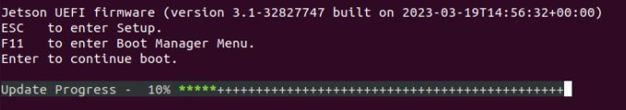
Debian package management-based OTA
You shall see latest rel-35.4 version got installed after the progress is done and enter kernel
You shall see latest rel-35.4 version got installed after the progress is done and enter kernel.
Note: NVIDIA provides Jetson Linux and JetPack Debian packages for use on NVIDIA Jetson Developer Kits. Applying NVIDIA packages when using a non-NVIDIA carrier board may lead to update or boot failure.
For partner-sourced systems, please contact the vendor for their own packages or APT server information.
To modify the NVIDIA provided Debian packages for use with a custom carrier board, use the tools provided under Linux_for_Tegra/tools/Debian in the BSP directory.
Notes:
If there is no error reported from the console after executing the apt dist-upgrade command, then you can reboot the device and shall see UEFI start to update the bootloader. It may take about 5 minutes.
After UEFI is updated, the device shall boot into ubuntu again and you could check the nv_tegra_release to confirm you are using the target release version.
Please be aware that the default Debian packages are for NVIDIA developer kit use only. If you are using a custom board or 3rdparty board, then applying NVIDIA Debian package may lead to boot failure or update failure. So if you are using custom board, please contact the board vendor for customized Debian package instead of using NVIDIA deb files.
If you have a custom board and need to generate the package, you can follow the instruction we provide in the BSP directory.

Slide 10
Image-based OTA
Concept
  The OTA implementation depends upon A/B bootloader slots to be present
  It is a failsafe way to update the BSP on a Jetson device by writing pre-generated images to its partitions
Prerequisites
  x86 host machine in Ubuntu
    To update to new minor release (e.g. JP5.1.1 -> JP5.1.3)
    To update to new major release (e.g. JP5.1.3 -> JP6.0 GA)
  Jetson device
    Xavier series supporting update from JP4 to JP5, and JP5 to JP5
    Orin series supporting update from JP5 to JP5, and JP5 to JP6
Steps
  Prepare an OTA payload package on the host machine
  Trigger the OTA process on the target device
Notes:
The image-based OTA depends on A/B chains. It is a failsafe way to update the BSP on a Jetson device by writing pre-generated images to its partitions.​ If updating B slot fails, it still can boot up with A slot which has original image.
​
To run image-based OTA upgrade, we need to have a x86 host machine in Ubuntu, to do the preparation works.​
There are 2 kinds of upgrading. One is to update to new minor release like Jetpack 5.1.1 to Jetpack 5.1.3. Another is to update to new major release like Jetpack 5.1.3 to Jetpack 6.0 GA​
​
The host machine will be used to generate the package. ​
The Jetson device will use the generated OTA package from host to perform OTA update.​
​
We will go through the detail in later slides.

Slide 11
Image-based OTA
OTA Utilities
Host | l4t_generate_ota_package.sh | Generate the OTA payload package (ota_payload_package.tar.gz)
Target | nv_ota_start.sh | Extract OTA payload package and determine to trigger the OTA update procedure with or without layout change
Notes:
There are two tools that would be used by end users to conduct image based OTA. The first tool is to run on host machine and the second one is to run on Jetson device.​
​
The first tool is the script called “l4t_generate_ota_package.sh”. This tool is used for generating the OTA payload package.​
​
The second tool which is run on the jetson device is called “nv_ota_start.sh”. From its name, you can tell it is for Jetson device to start the OTA process.​

Slide 12
Image-based OTA
Prerequisites on host
Note: Jetpack 6.0 GA(R36.3) supports only updating from Jetpack 5.1.3(R35.5.0) for Orin series
Set TARGET_BSP and BASE_BSP path
  Target BSP: the BSP path you want to upgrade to
  Base BSP: the BSP path you want to upgrade from
  Example: upgrading from Jetpack5.1.3 to Jetpack6.0GA
  $ export BASE_BSP=/home/chunhuaif/nvidia/nvidia_sdk/JetPack_5.1.3_Linux_JETSON_ORIN_NX_TARGETS/Linux_for_Tegra
  $ export TARGET_BSP=/home/chunhuaif/nvidia/nvidia_sdk/JetPack_6.0_Linux_JETSON_ORIN_NX_TARGETS/Linux_for_Tegra
Download the OTA Tools of target release from the Jetson Linux website and install it
  $ cd ${TARGET_BSP}/..
  $ wget https://developer.nvidia.com/downloads/embedded/l4t/r36_release_v3.0/release/ota_tools_R36.3.0_aarch64.tbz2
  $ tar xjpf ota_tools_R36.3.0_aarch64.tbz2
Notes:
Let’s start to run the image-based OTA step by step. We will take an example with image-based OTA from Jetpack 5.1.3 to Jetpack 6.0 GA.​
Please noted that for upgrading to Jetpack 6.0 GA, you must upgrade the Jetson device to Jetpack 5.1.3 first.
​
To run this OTA, there are some prerequisites on the x86 host. First, you have to set the target bsp path and base bsp path.​
A target BSP means the target version you want to upgrade to.​
A base BSP means the base bsp you are upgrading from.​
​
For example, if you want to upgrade from Jetpack 5.1.3 to Jetpack 6.0 GA, then the base BSP version would be Jetpack 5.1.3 and the target version would be Jetpack 6.0 GA.​
​
Secondly, you have to download the OTA upgrade tools and install it to the target BSP.​

Slide 13
Image-based OTA
Prerequisites on Jetson
Download the OTA Tools of target release from the Jetson Linux website and send it to Jetson device
  $ cd ${HOME}
  $ wget https://developer.nvidia.com/downloads/embedded/l4t/r36_release_v3.0/release/ota_tools_R36.3.0_aarch64.tbz2
  $ tar xjpf ota_tools_R36.3.0_aarch64.tbz2
Put OTA payload from x86 host machine to Jetson device
Notes:
​
There are also prerequisites on the Jetson side.
First, you need to download the OTA tools to Jetson device too.
Second, you need to put the OTA package generated from the host machine to the home directory on Jetson device

Slide 14
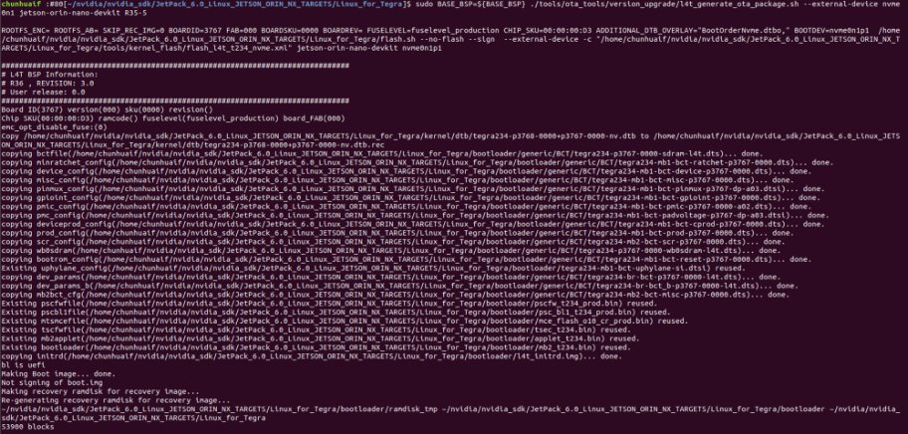
Image-based OTA
OTA Process
Generate the OTA payload package from R35.5.0 to R36.3.0 on host machine
  $ cd ${TARGET_BSP}
  $ sudo BASE_BSP=${BASE_BSP} ./tools/ota_tools/version_upgrade/l4t_generate_ota_package.sh --external-device nvme0n1 jetson-orin-nano-devkit R35-5
Notes:
To generate the OTA payload, you only need to change the working path to the target BSP and run above command to generate the package.​
​
The board config could be something else. In the example, it is “jetson-orin-nano-devkit” since we use Orin Nano board. You need to change it to your board config.​
​
And the last parameter is the base release version we are using. It is rel-35.5 in this example.

Slide 15
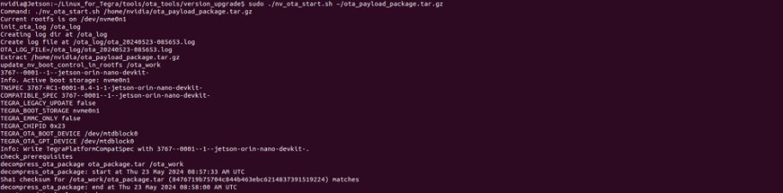
Image-based OTA
OTA Process
Send the OTA payload package generated from (1) to Jeston ${HOME} directory
Run below command to start the OTA process on Jetson
  $ cd ~/Linux_for_Tegra/tools/ota_tools/version_upgrade
  $ sudo ./nv_ota_start.sh ~/ota_payload_package.tar.gz
Notes:
After the OTA payload is generated, the next step is to send this package to the home directory on jetson.​
Then, run above command to unpack the OTA payload package and prepare for upgrade.​

Slide 16
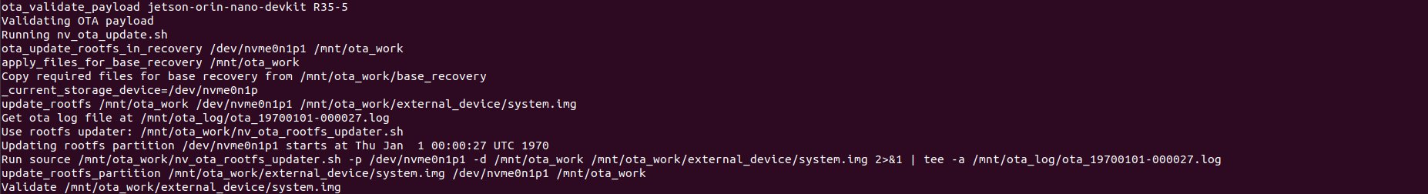
Image-based OTA
OTA Process
After step(3) finishes, reboot the Jetson and it will start updating rootfs after boot up
Then, it will update bootloader in UEFI
After update process, system shall boot up from the chain that was newly upgraded to R36.3.0
Notes:
After the preparation is finished, you can reboot the device and it will update root file system first after boot up.​
Then, it will update bootloader in UEFI, and you will see progress bar, same as we see in Debian package upgrade.​
​
After UEFI update is done, system shall reboot from the chain that was upgraded to the target version.​
You can run nvbootcontrol command to show the current status.​
You will see the BSP version is updated to the target version and the capsule update status is 1.​
​
Currently, slot B is updated successfully but not yet for slot A

Slide 17
Image-based OTA
OTA Process
(Step (6) to step (10) are similar as step(1) to step (5))
Generate the OTA payload package from R36.3.0 to R36.3.0 on host machine
  $ cd ${TARGET_BSP}
  $ sudo ./tools/ota_tools/version_upgrade/l4t_generate_ota_package.sh --external-device nvme0n1 jetson-orin-nano-devkit R36-3
Send the OTA payload package generated from (6) to Jeston ${HOME} directory
Run below command to start the OTA process on Jetson
  $ cd ~/Linux_for_Tegra/tools/ota_tools/version_upgrade
  $ sudo ./nv_ota_start.sh ~/ota_payload_package.tar.gz
After step(8) finishes, reboot the Jetson and it will start the update process
After update process, system shall boot up from the chain that was newly upgraded to R36.3.0. Now both bootloader chains and both rootfs on the NVMe storage device are upgraded to R36.3.0
Notes:
The Step 6 to Step 10 are performed to update slot A, and they are similar as Step 1 to Step 5.
In Step 10, if your update succeeds, you can run nvbootcontrol command again to show the new status.
Now, both bootloader and root file system are upgraded to R36.3.0

Slide 18
Practical Examples
NVIDIA Developers Forum Topics
  Topic 260317 Image-Based OTA Failed
  Topic 292961 Update Jetpack 6.0 GA from 5.1.3 with OTA Update on Jetson AGX Orin DevKit
  Topic 292550 Jetson Orin Nano won't update from 3.x to 5.x firmware
Known limitations
  Versions < rel-35.5.0 releases may not be able to directly upgrade to rel-36 releases. The table indicates which release to use. If you are using older one, need to upgrade to the version on list first before upgrade to rel-36
Notes:
One thing you should keep in mind is,
If your base BSP version is older than rel-35.5.0, then it would not be able to directly upgrade to rel-36 through image based OTA.​
There is a table here to indicate which version is capable of doing such upgrade directly. You need to upgrade to that version first if you want to upgrade to rel-36.

Slide 19
Reference Links
Documents
  R36.3 Developer guide
    Overall: Software Packages and the Update Mechanism
    Customization: Complete and Secure the OTA
  <Linux_for_Tegra>/tools/ota_tools/version_upgrade/Image_based_OTA_Examples.txt
elinux WIKI
  https://elinux.org/Jetson/L4T/peripheral/#Image-Based_OTA_with_layout_change
Notes:
The last page here are some reference website for NVIDIA official document.​
​
If you want to know more detail about the OTA upgrade mechanism, then you could refer to above links.​
​

Slide 20
Notes:
Thank you for listening.

